Slide 1
US Housing Market Analysis & Insights: 2008 – 2019
By: Adam Iona, Chris Marchini, Remco Mooij, and Tolo Omotunde
1/21/2020

Slide 2
Agenda
Project Overview
Key Questions & Data Sources/Data Used
Data Cleanup & Exploration
Data Analysis Process + Answered Questions
Discussion of Results
Postmortem & Future Research
Questions

Slide 3
Project Overview
Goal
Analyze the housing market between 2008 and 2019.
What we analyzed
Top states with highest median sales price increases and decreases
Results
Median prices sales prices for homes steadily increased nationwide starting around 2011-2012
Housing median sales prices and foreclosure resales
Relationship between consumer/market variables and housing prices for top states
Future median sales prices based on relationships between consumer/market variables and median sales prices
Housing prices increased the most in DC, CA, CO, WA, and MA since 2008
Housing prices decreased the most in CT, NJ, MD, NM, and WV since 2008.
Different variables affected housing prices more than others by state
Determine where and why the housing market has rebounded since its collapse around 2008
Wanted to make an analysis to help potential homeowners better understand the housing market (e.g. how are prices trending, where’s cheaper/more expensive, etc.)
Nationwide, housing prices are projected to go up.

Slide 4
Key Questions
How have the average median house sales and foreclosure resale rates trended since 2008?
What are the top five states with the highest increases and highest decrease in median house prices since 2008?
What consumer/market variables affected median sales prices for homes since 2008?
Based on the results of Question 3, what may future median sales prices look like?

Slide 5
Data Sources and Data Used
Key Questions | Primary Data Sources | Data Used
 |  | Zillow Home Value Index | Med. Sale Price | Monthly Home Sales | Foreclo. Resales | Divorce Rates | Unemploy. Rates | Student Loan Debt | Total Debt | Median Household Income
1 | Zillow | x | x |  | x
2 | Zillow |  | x
3 | Zillow, CDC/NCHS, Bureau of Labor Statistics, New York Federal Consumer Credit Panel/Equifax, Census Bureau | x | x | x | x | x | x | x | x | x
4 | Zillow, CDC/NCHS, Bureau of Labor Statistics, New York Federal Consumer Credit Panel/Equifax, Census Bureau | x | x | x | x | x | x | x | x | x

Slide 6
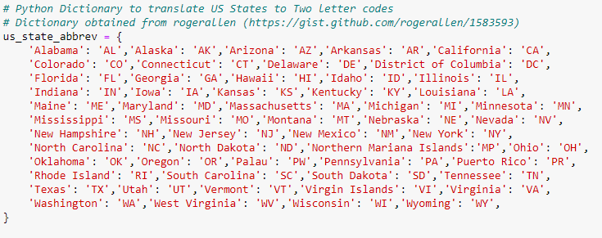
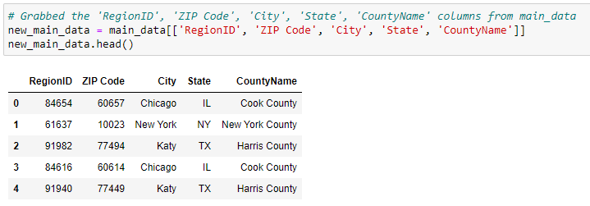
Data Cleanup & Exploration
Data Cleanup
Data Exploration
Cleanup was straightforward but lengthy
Several disparate data sources, but luckily had one common variable: states
Converted state names to state abbreviations to merge data on later
Checked dataframes to ensure data was correct

Slide 7
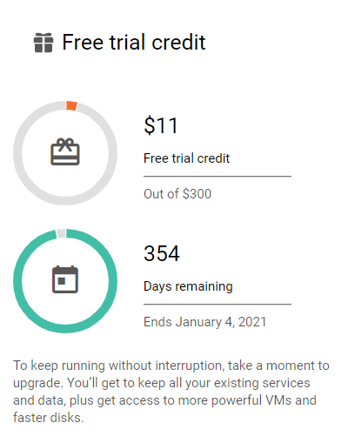
Data Cleanup & Exploration
Data Cleanup
Data Exploration
We noticed was how much data we had available and how difficult it was to choose some data over others
We tried using Google API to make a zip code level or state level, but it didn’t work. Also battled with Census API.
Zip code map alone burned up nearly one account’s free trial credit due to the amount of data and trying to re-run it
Prevented scope creep by reducing datasets for analysis, dropped heatmaps and Census API.

Slide 8
Data Analysis Process
Identify
Identified which the types of data we would need
Merge
Merged our data on a common variable, which for us was the state abbreviations
Isolate + Analyze
Isolated the data from our new merged data for analysis. Analyses included but weren’t limited to national/state averages, percent changes over the period analyzed, and multiple regressions.

Slide 9
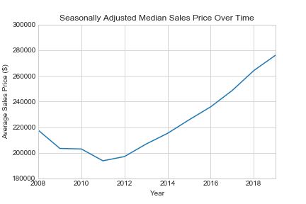
How have the average median house sales and foreclosure resale rates trended since 2008?
Average Median House Sales
Foreclosure Resales %
The national average median sales prices began increasing in 2011 and have continued to increase since then, indicating when the market started to rebound
Notes:
Data source: Zilllow
Data used: Zillow Home Index Value

Slide 10
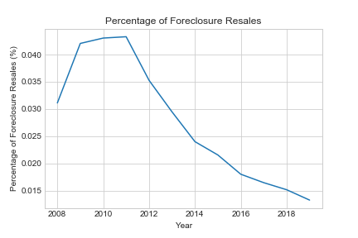
How have the average median house sales and foreclosure resale rates trended since 2008?
Average Median House Sales
Foreclosure Resales %
The foreclosure resales percentages have steadily declined since 2011 and continue to trend downward, which further indicates 2011 was a pivotal year for the market’s rebounding.
Notes:
Data source: Zilllow
Data used: Zillow Home Index Value

Slide 11
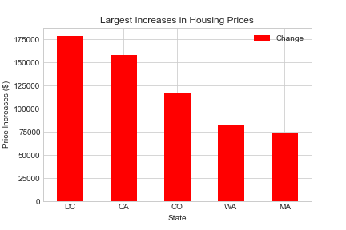
What are the top 5 states with the highest increases and highest decrease in median house prices since 2008?
Top 5 States with Highest Increases
Top 5 States with Highest Decreases
Since 2008, DC, California, Colorado, Washington, and Massachusetts saw the highest increases in house prices
Notes:
Data source: Zilllow
Data used: Zillow Home Index Value

Slide 12
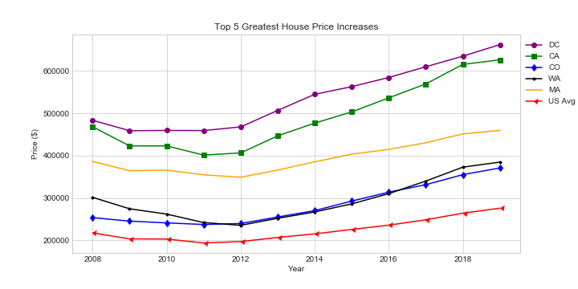
What are the top 5 states with the highest increases and highest decrease in median house prices since 2008?
Top 5 States with Highest Increases
Top 5 States with Highest Decreases
DC, California, Colorado, Washington, and Massachusetts had median sales price increases starting around 2011-2012, which follows a consistent pattern the national median sales price average.
Notes:
Data source: Zilllow
Data used: Zillow Home Index Value

Slide 13
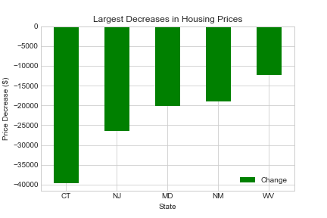
What are the top 5 states with the highest increases and highest decrease in median house prices since 2008?
Top 5 States with Highest Increases
Top 5 States with Highest Decreases
Connecticut, New Jersey, Maryland, New Mexico, and West Virginia saw the highest decreases in house prices
Notes:
Data source: Zilllow
Data used: Zillow Home Index Value

Slide 14
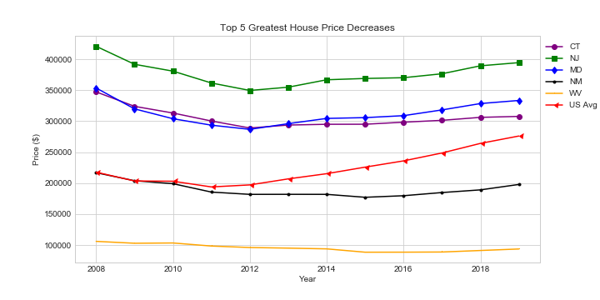
What consumer/market variables affected median housing prices since 2008?
Top 5 States with Highest Increases
Top 5 States with Highest Decreases
New Jersey, Maryland, and Connecticut appear to have begun rebounding around 2012, whereas New Mexico and West Virginia started slowly rebounding around 2015.
Notes:
Data source: Zilllow
Data used: Zillow Home Index Value

Slide 15
What consumer/market variables affected median housing prices since 2008?
We ran a multiple regression analysis to see how strongly correlated the following eight variables are to median sales prices:
Zillow Home Index Value
Monthly Home Sales
Foreclosure Resales
Divorce Rates
Unemployment Rates
Student Loan Debt
Total Debt
Household Median Income
The strength of these variables’ correlations with median sales prices fluctuated from state to state.
We’re showing the top three correlated variables for DC and Connecticut to be illustrative.
Notes:
Data source: Zilllow
Data used: Zillow Home Index Value

Slide 16
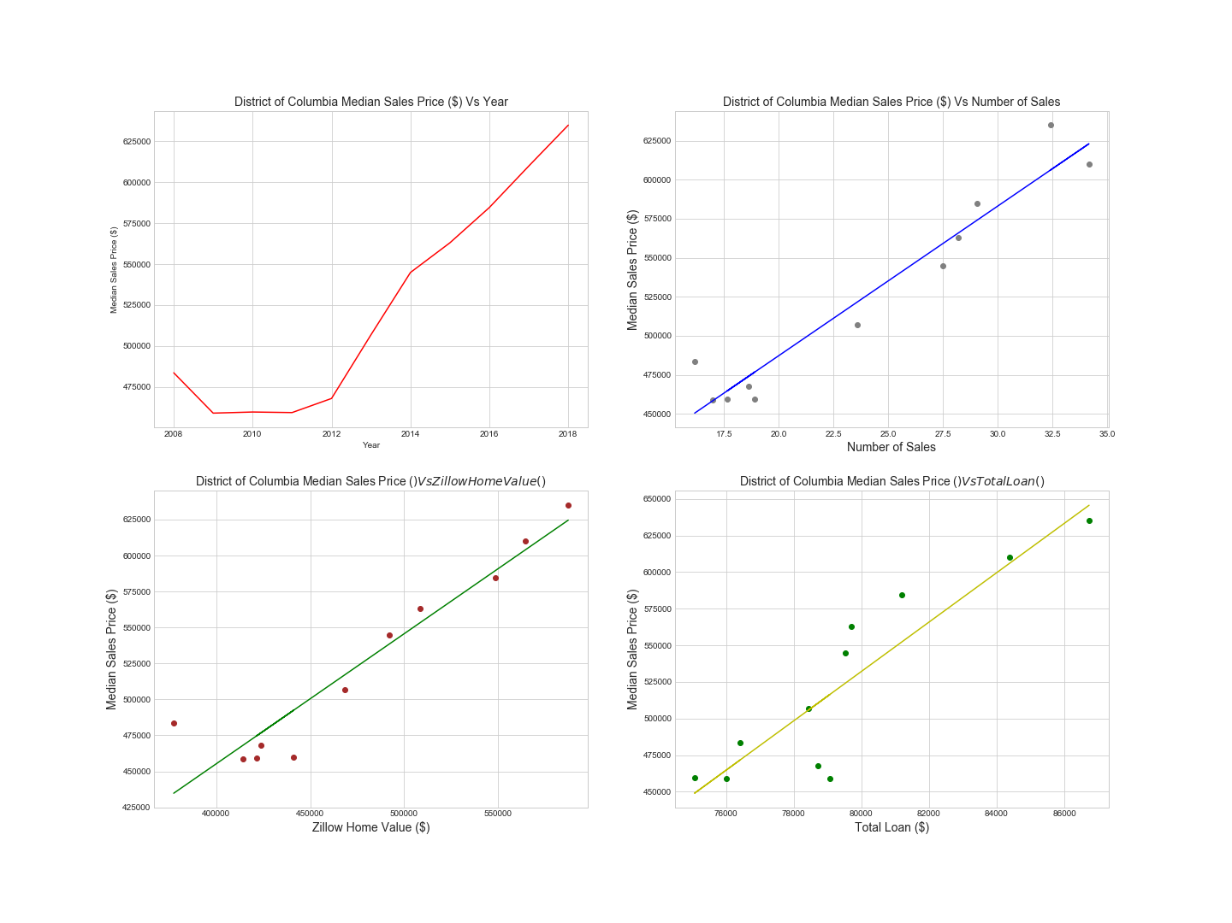
What consumer/market variables affected median housing prices since 2008?
Example w/ Highest Price Increase (DC)
Example w/ Highest Price Decrease (CT)
Notes:
Data source: Zilllow
Data used: Zillow Home Index Value

Slide 17
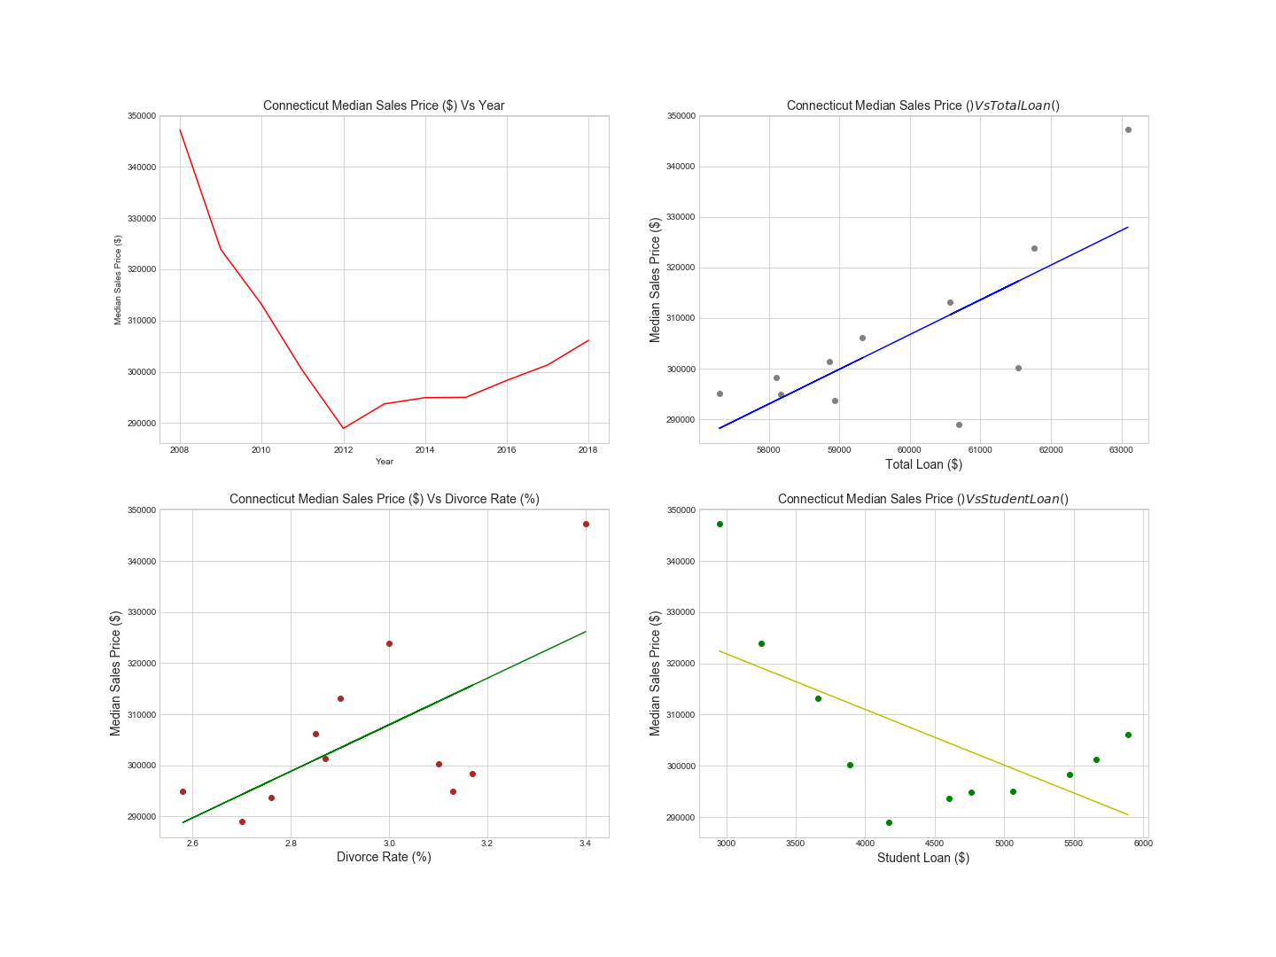
What consumer/market variables affected median housing prices since 2008?
Example w/ Highest Price Increase (DC)
Example w/ Highest Price Decrease (CT)

Slide 18
Based on the results of Question 3, what may future median sales prices look like?
Example w/ Highest Price Increase
Example w/ Highest Price Decrease
Need graphics – maybe just show DC?

Slide 19
Based on the results of Question 3, what may future median sales prices look like?
Example with Highest Increase
Example with Highest Decrease
Need graphics –just show CT and put the remaining states in the appendix?

Slide 20
Discussion of Results
We found most answers about the market rebounding:
Median sales prices increased/foreclosures decreased around ‘11-’12
NM and WV didn’t start to rebound until 2015
Different variables affected the house prices by state
The market outlook per state is different depending on the variables
Things that remain unclear based on our results:
Was there a specific event in 2011 that caused the housing market to mostly rebound?
Why didn’t NM and WV housing prices rebound around 2011-2012?
Why did certain variables affect other states more than others?

Slide 21
Postmortem + Future Research
Key issues we encountered included:
Inability to show heat maps at the zipcode/state level
Pulling and organizing some datasets was more difficult than we thought (e.g., BLS data, Census API).
Preventing scope creep with additional variables
Merging our disparate data into one Jupyter Notebook.
Future research recommendations:
What other variables might determine why the housing market rebounded (e.g., population data, poverty rates, education)?
Why did states like NM and WV not rebound in 2011?
What would this model look like applied at more of the local level?
How did the rental market change in comparison to the housing market?

Slide 22
Thank you! Questions?

Slide 23
Appendix

Slide 24
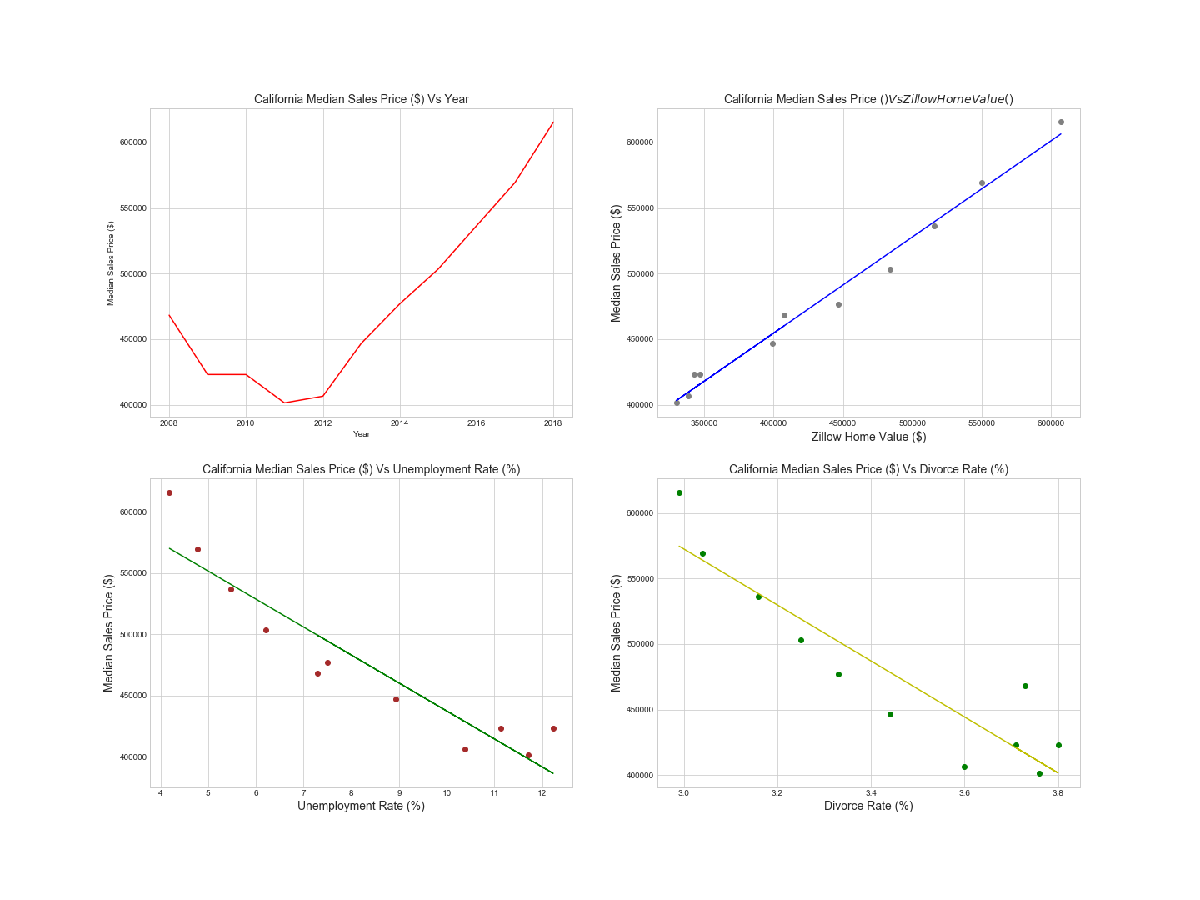
For states with the highest median sales price increase, what consumer/market variables affected median housing prices since 2008?
California
Colorado
Washington
Massachusetts
Notes:
Data source: Zilllow
Data used: Zillow Home Index Value

Slide 25
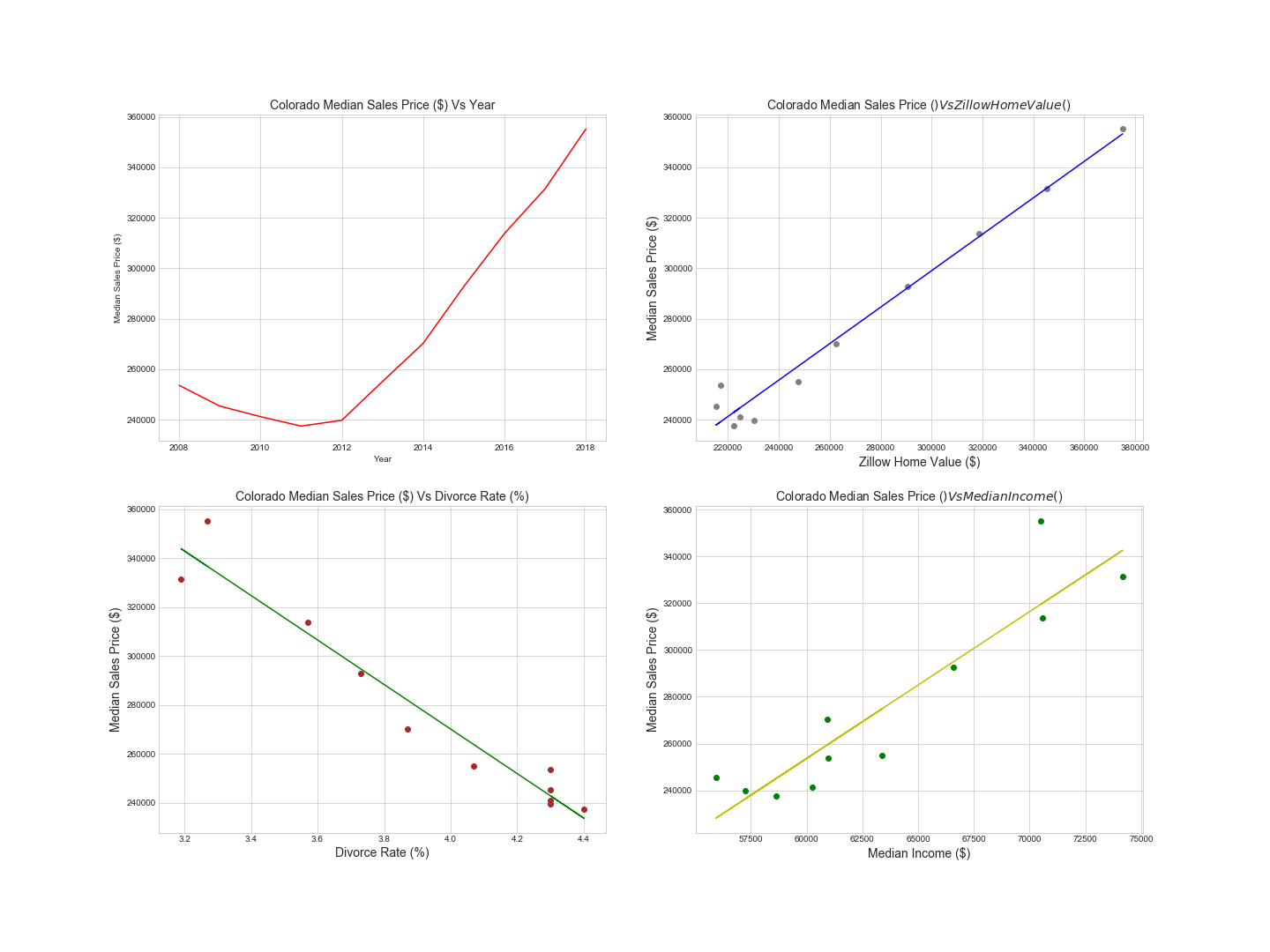
For states with the highest median sales price increase, what consumer/market variables affected median housing prices since 2008?
California
Colorado
Washington
Massachusetts
Notes:
Data source: Zilllow
Data used: Zillow Home Index Value

Slide 26
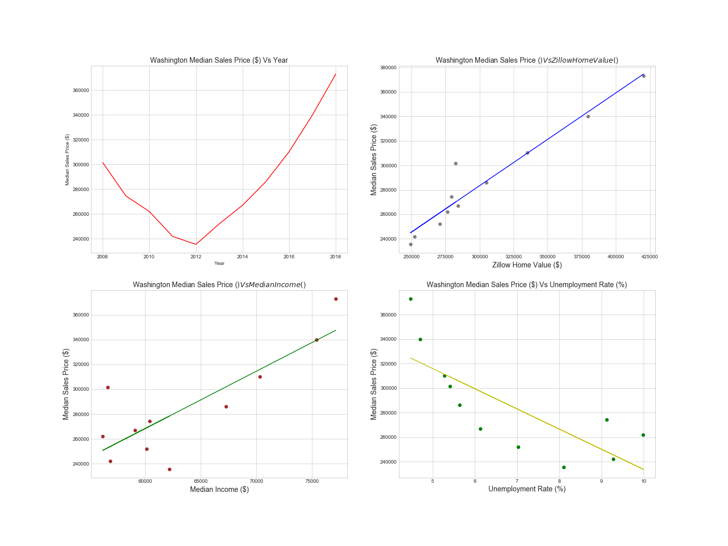
For states with the highest median sales price increase, what consumer/market variables affected median housing prices since 2008?
California
Colorado
Washington
Massachusetts
Notes:
Data source: Zilllow
Data used: Zillow Home Index Value

Slide 27
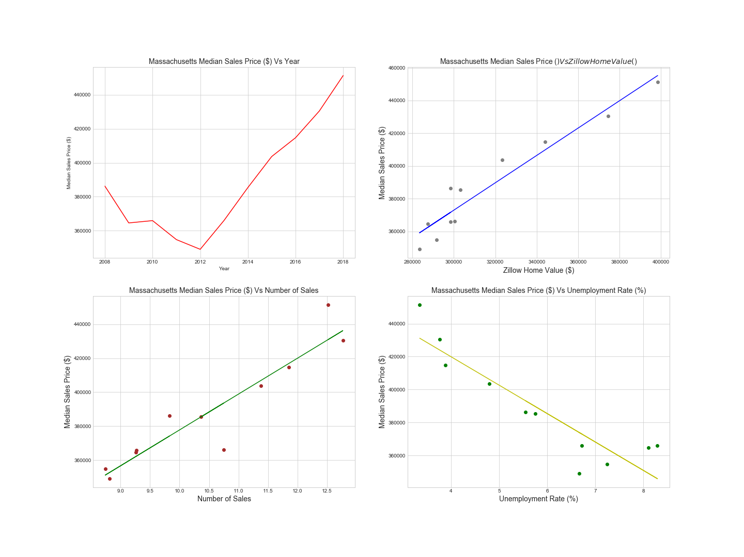
For states with the highest median sales price increase, what consumer/market variables affected median housing prices since 2008?
California
Colorado
Washington
Massachusetts
Notes:
Data source: Zilllow
Data used: Zillow Home Index Value

Slide 28
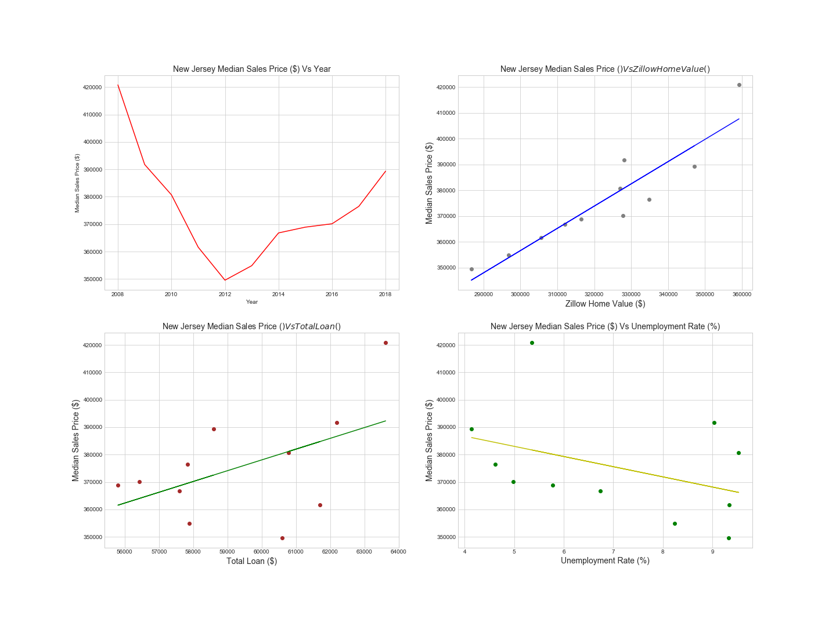
For states with the highest median sales price decreases, what consumer/market variables affected median housing prices since 2008?
New Jersey
Maryland
New Mexico
West Virginia
Notes:
Data source: Zilllow
Data used: Zillow Home Index Value

Slide 29
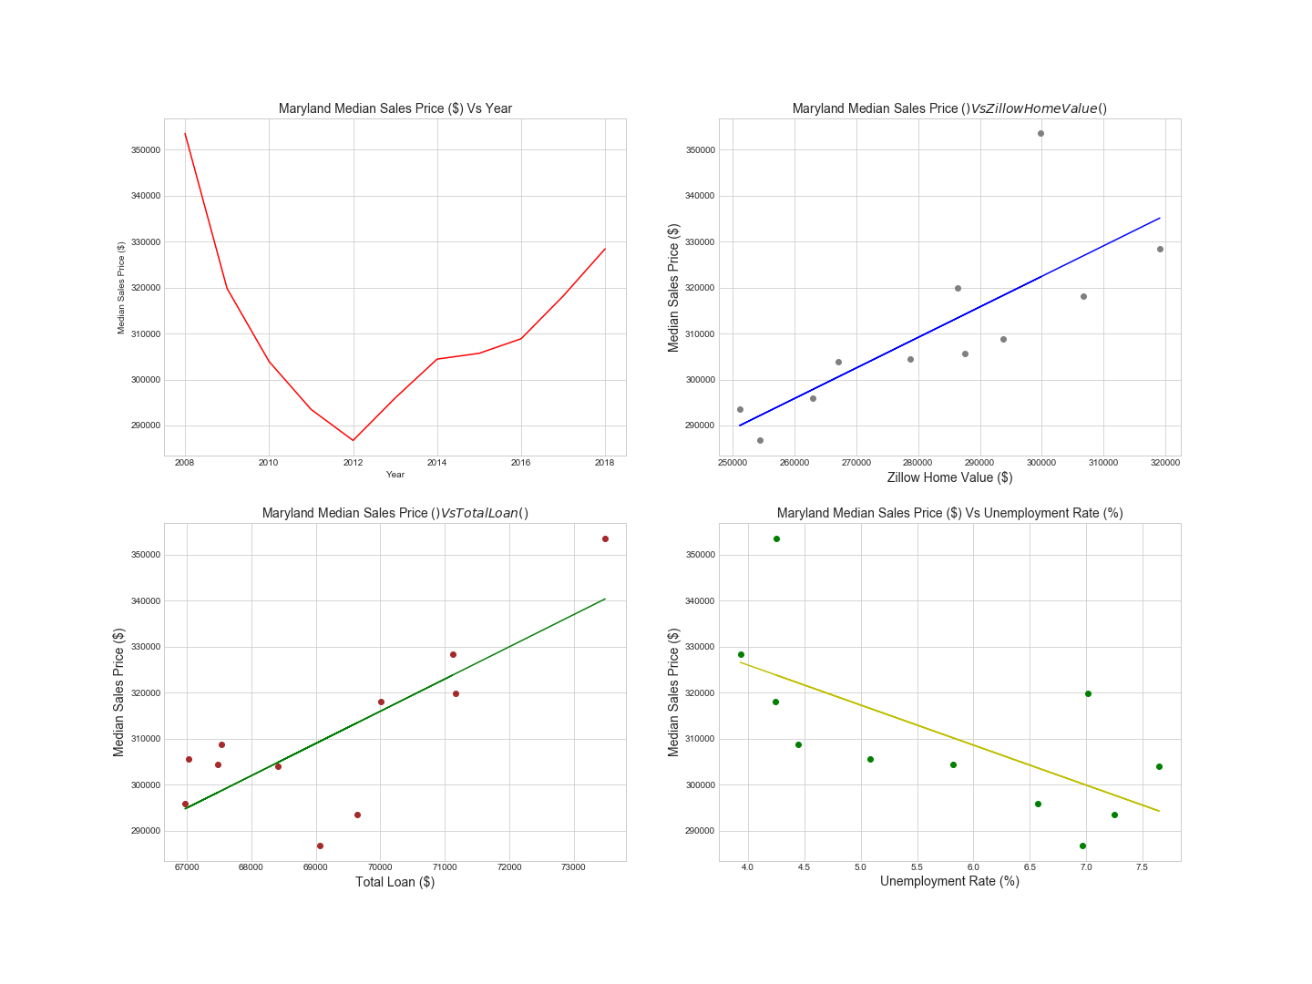
For states with the highest median sales price decreases, what consumer/market variables affected median housing prices since 2008?
New Jersey
Maryland
New Mexico
West Virginia
Notes:
Data source: Zilllow
Data used: Zillow Home Index Value

Slide 30
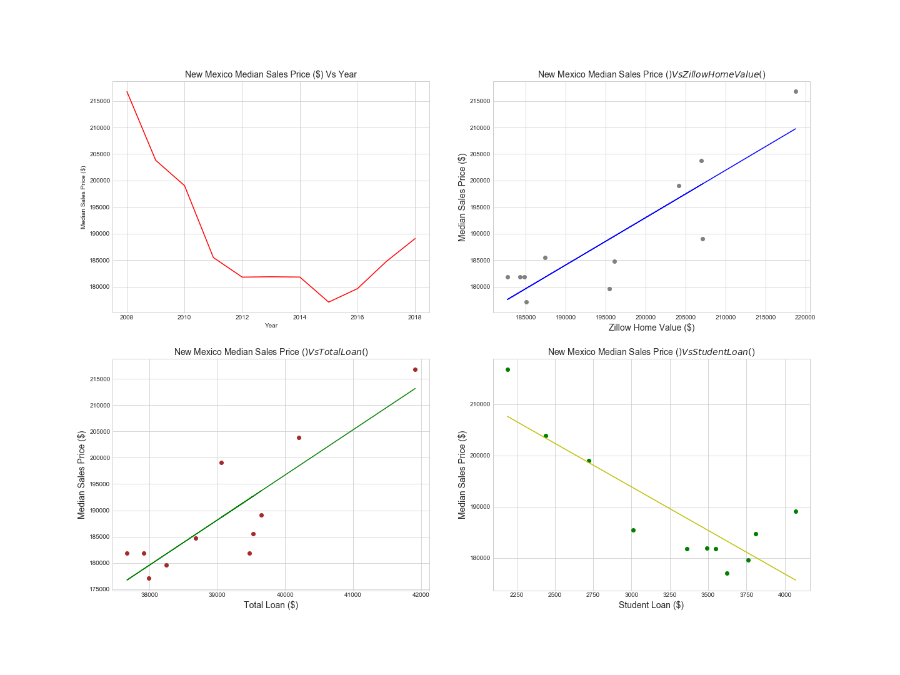
For states with the highest median sales price decreases, what consumer/market variables affected median housing prices since 2008?
New Jersey
Maryland
New Mexico
West Virginia
Notes:
Data source: Zilllow
Data used: Zillow Home Index Value

Slide 31
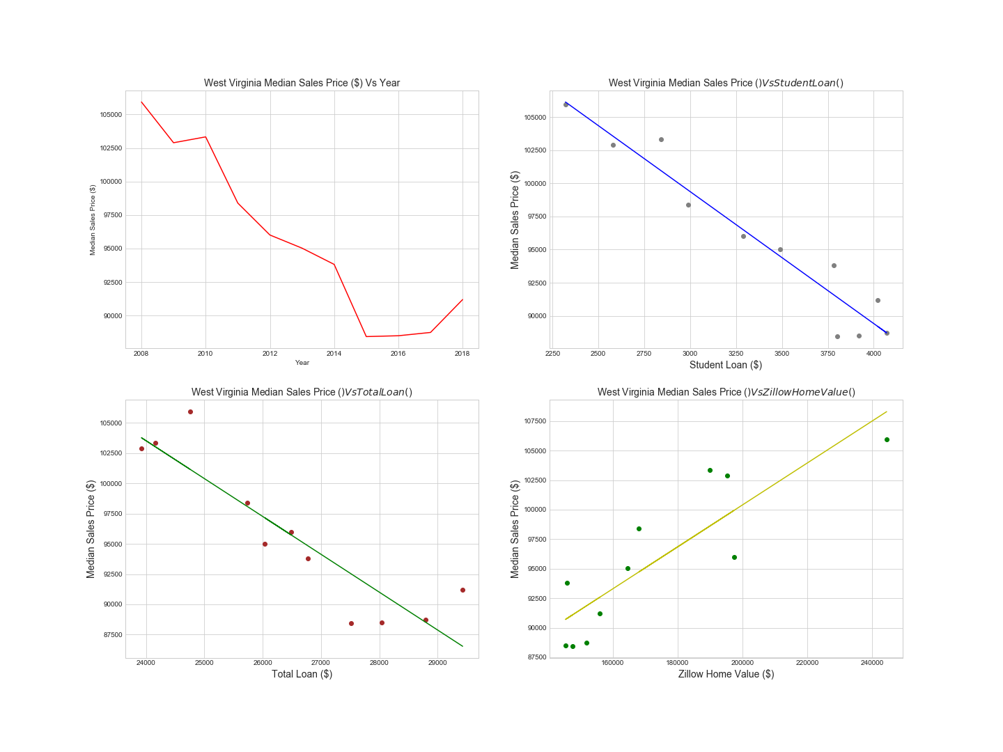
For states with the highest median sales price decreases, what consumer/market variables affected median housing prices since 2008?
New Jersey
Maryland
New Mexico
West Virginia
Notes:
Data source: Zilllow
Data used: Zillow Home Index Value

